Slide 1
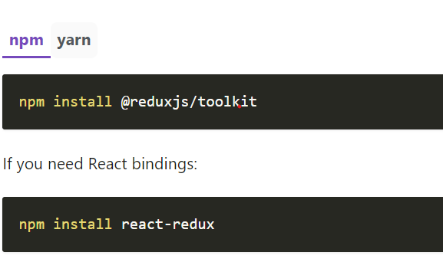
Redux Tool Kit
The Redux Toolkit package is intended to be the standard way to write Redux logic. It was originally created to help address three common concerns about Redux:
"Configuring a Redux store is too complicated"
"I have to add a lot of packages to get Redux to do anything useful"
"Redux requires too much boilerplate code"
Installation

Slide 2
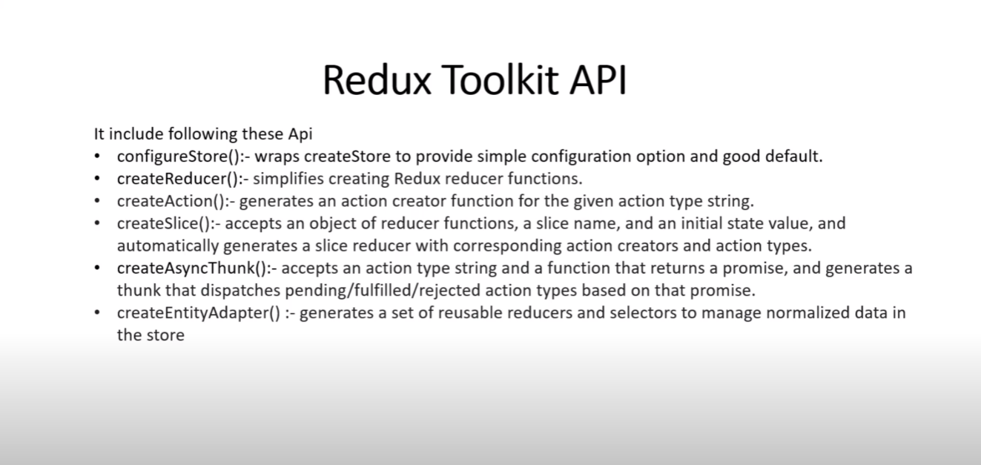
Redux Toolkit API

Slide 3
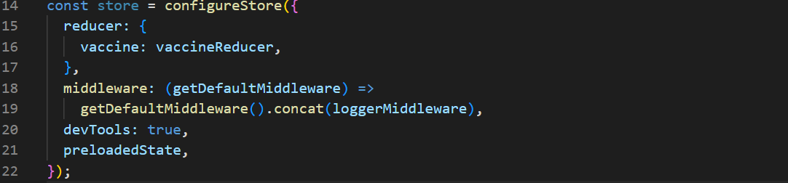
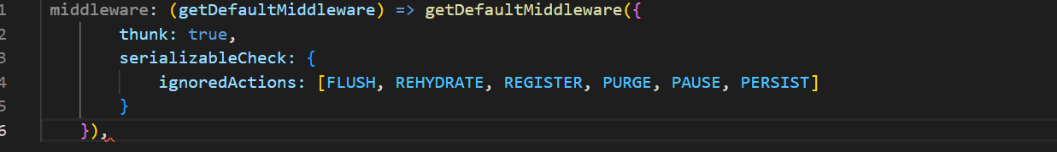
Configure Store
A friendly abstraction over the standard Redux createStore function that adds good defaults to the store setup for a better development experience.
Default Middleware

Slide 4
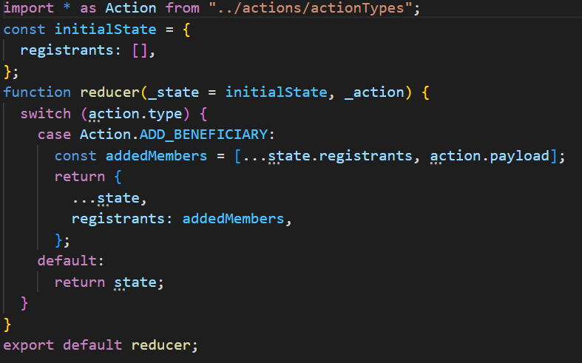
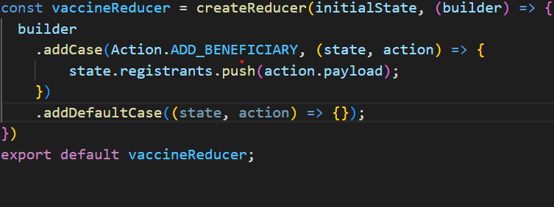
Create Reducer
A utility that simplifies creating Redux reducer functions. It uses Immer internally to drastically simplify immutable update logic by writing "mutative“ code
in your reducers, and supports directly mapping specific action types to case reducer functions that will update the state when that action is dispatched

Slide 5
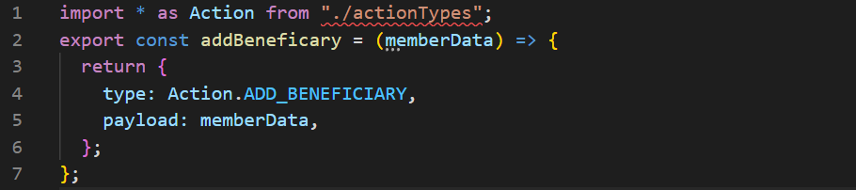
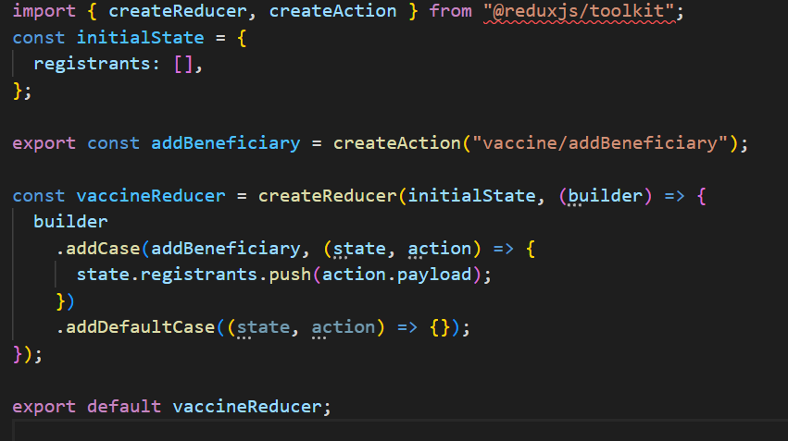
Create Action
A helper function for defining a Redux action type and creator.

Slide 6
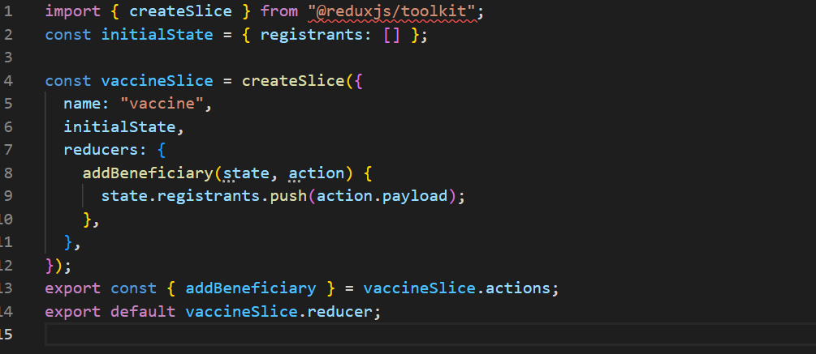
Create Slice
A function that accepts an initial state, an object of reducer functions, and a "slice name", and automatically generates action creators and action types that correspond to the reducers and state.

Slide 7
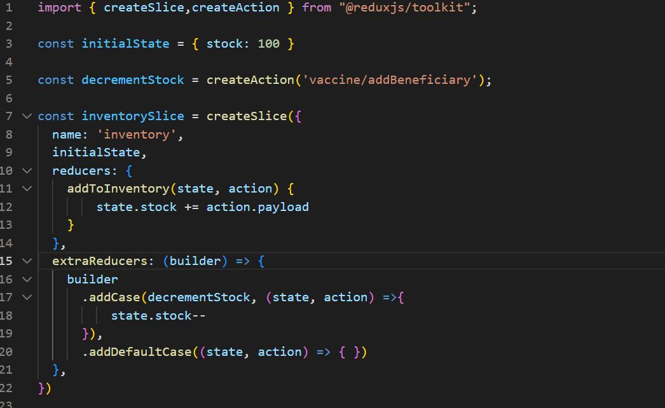
Extra Reducers
One of the key concepts of Redux is that each slice reducer "owns" its slice of state, and that many slice reducers can independently respond to the same action type. extraReducers allows createSlice to respond to other action types besides the types it has generated.

Slide 8
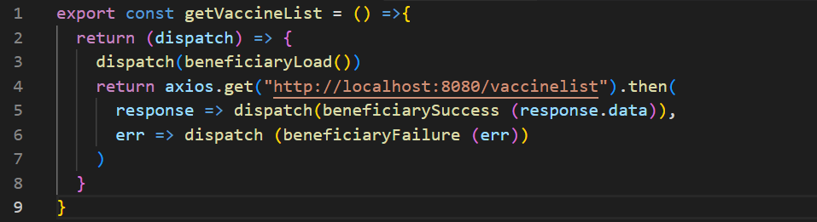
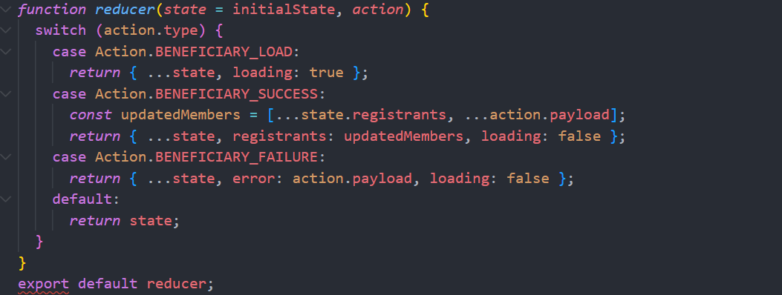
Create Async Thunk
A function that accepts a Redux action type string and a callback function that should return a promise. It generates promise lifecycle action types based on the action type prefix that you pass in, and returns a thunk action creator that will run the promise callback and dispatch the lifecycle actions based on the returned promise.

Slide 9
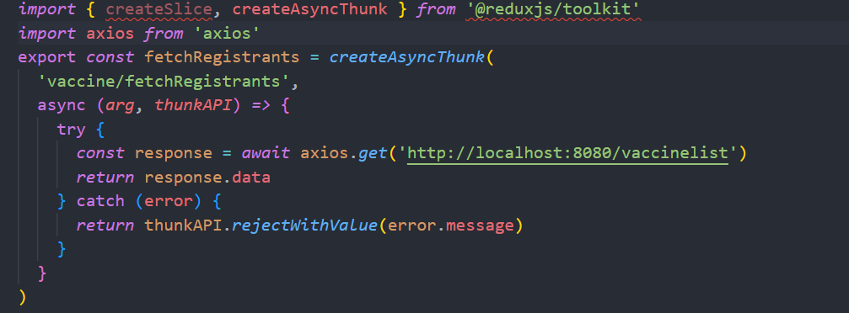
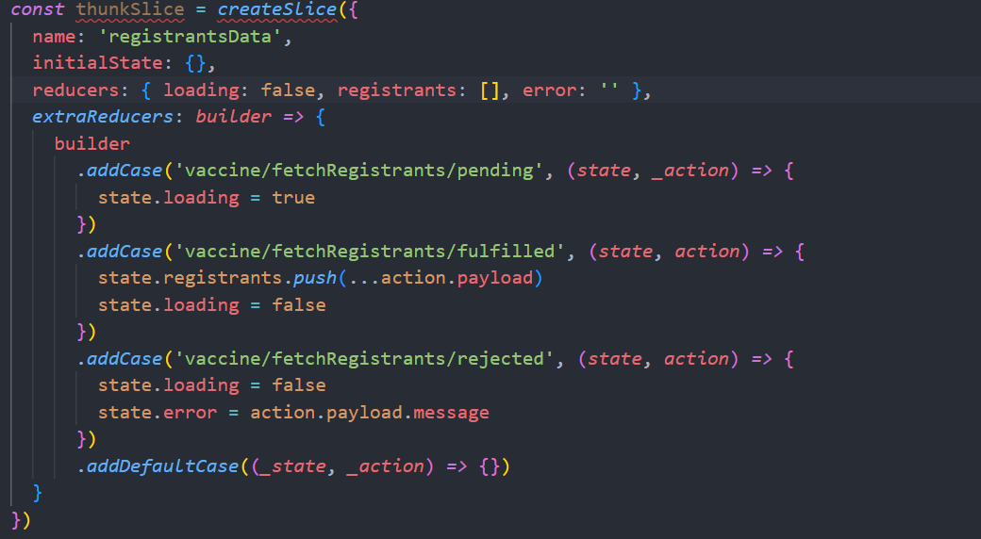
Create Async Thunk

Slide 10
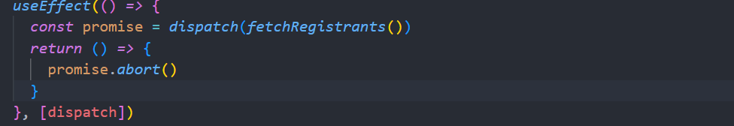
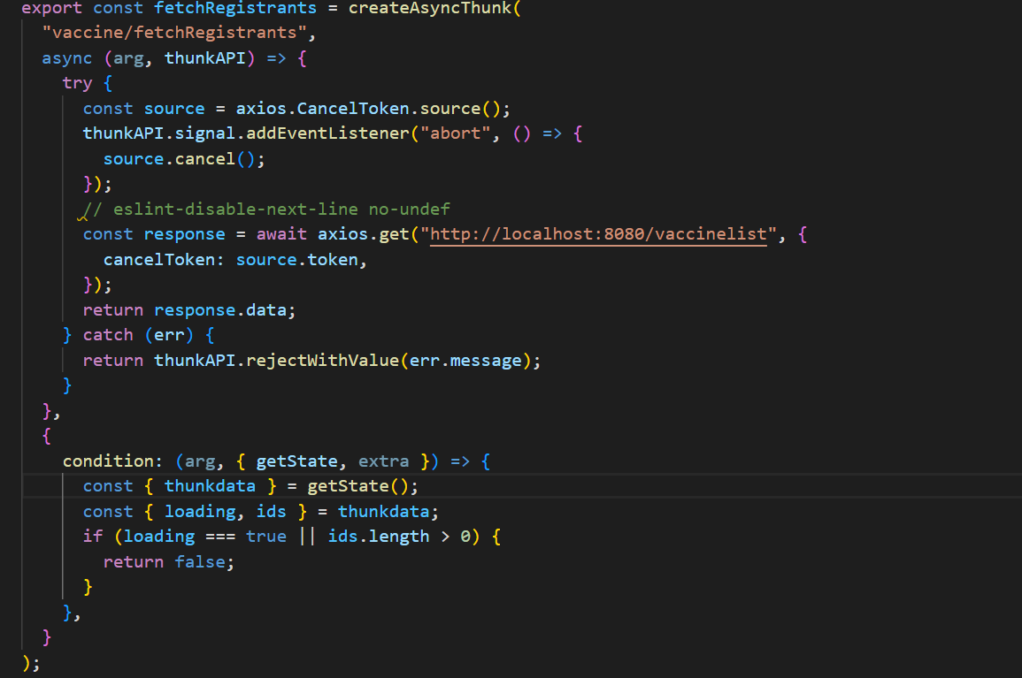
Create Async Thunk- Cancellation

